Slide 1



Cybersecurity and you 101
VU StudSec STORM EducaCie

Slide 2


Slide 3


Slide 4
Who are we
VU Studsec
Our goal:
Expand the Cybersecurity field outreach to more people. (you!)
Through regular meetups and workshops

Slide 5
What is cybersecurity?
The protection of information and information systems from unauthorized access and disruption.
Notes:
What is cybersecurity?

Slide 6
Why cybersecurity?

Slide 7
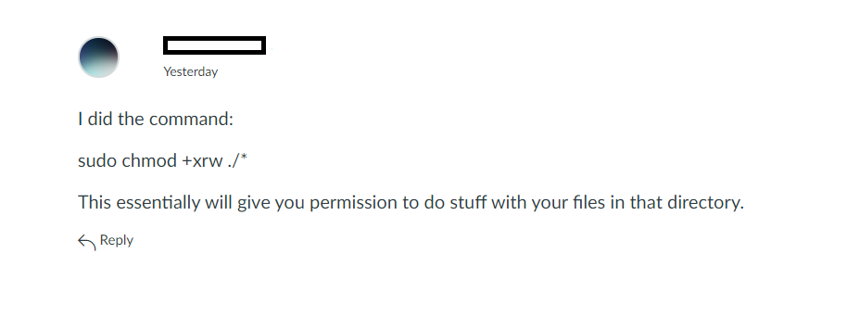

Slide 8
Story time

Slide 9
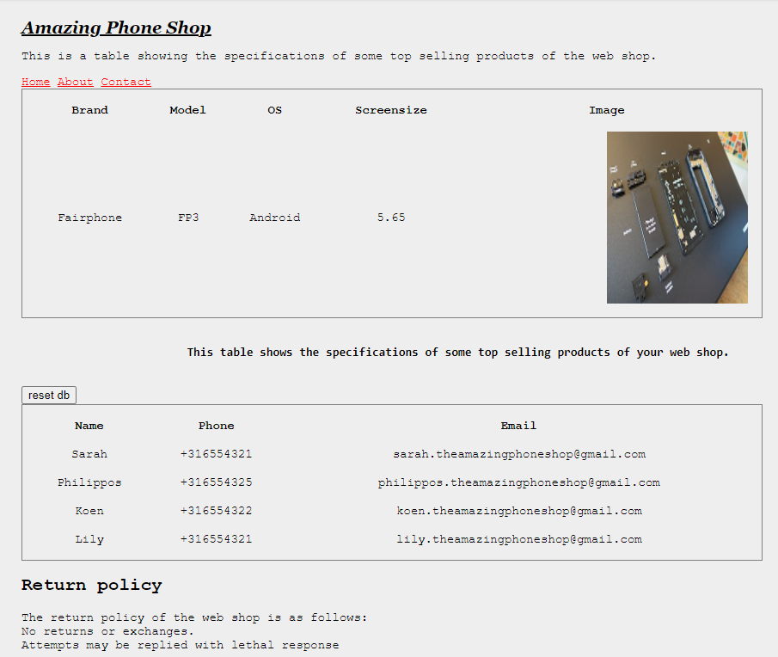
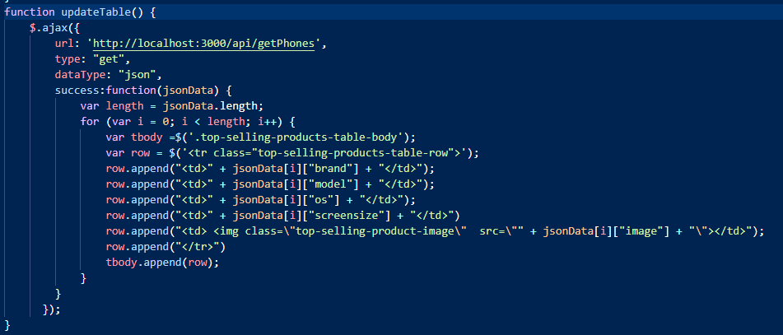

Slide 10
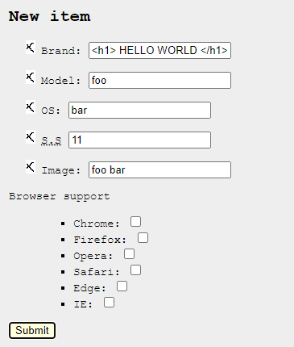
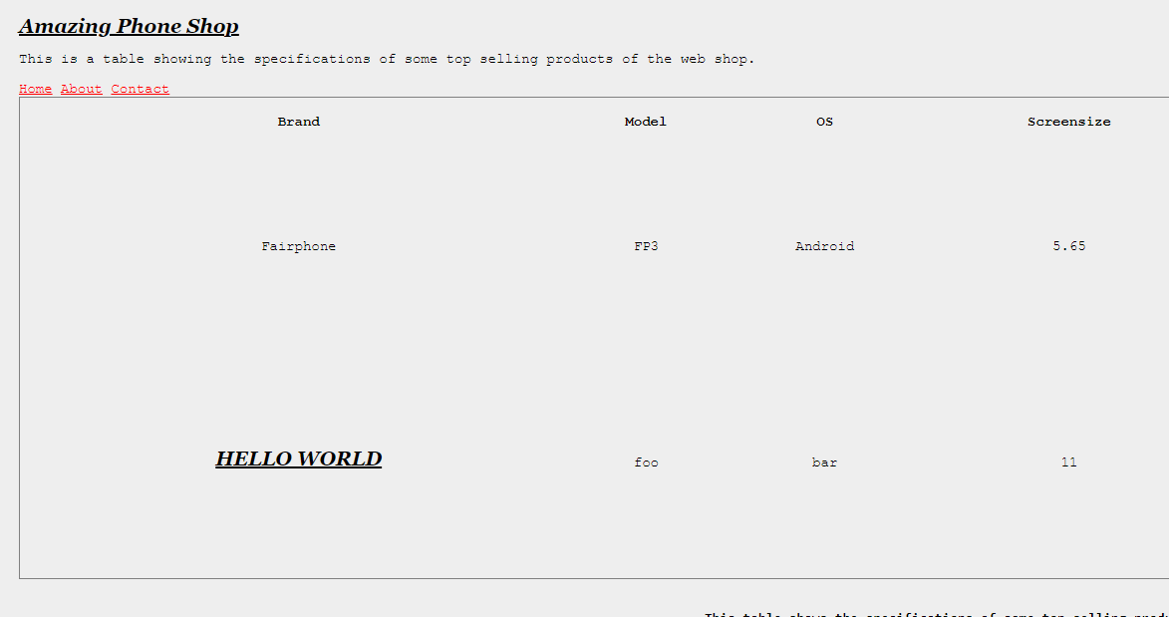

Slide 11
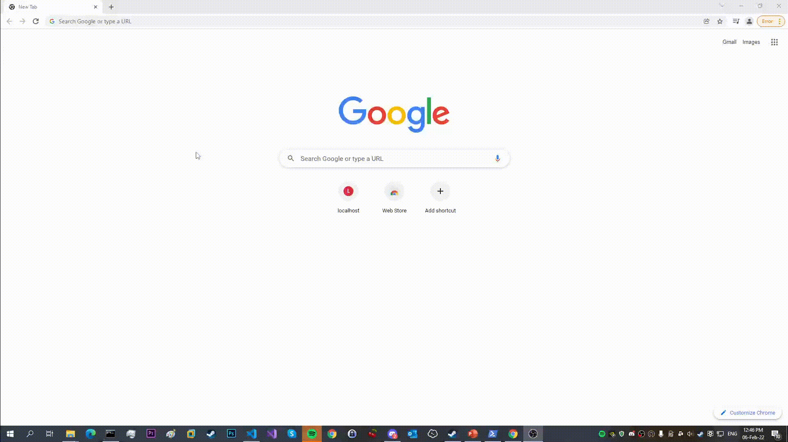
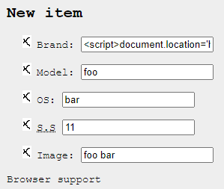

Slide 12
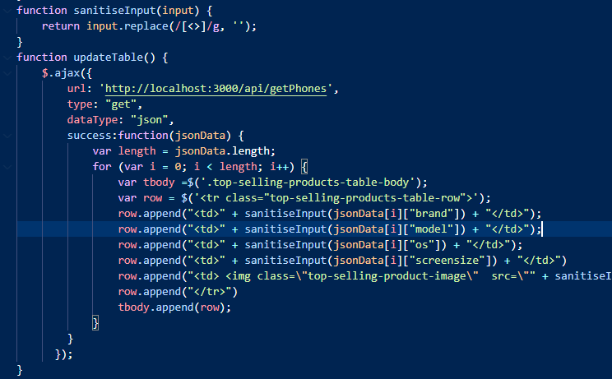
Solution:

Slide 13
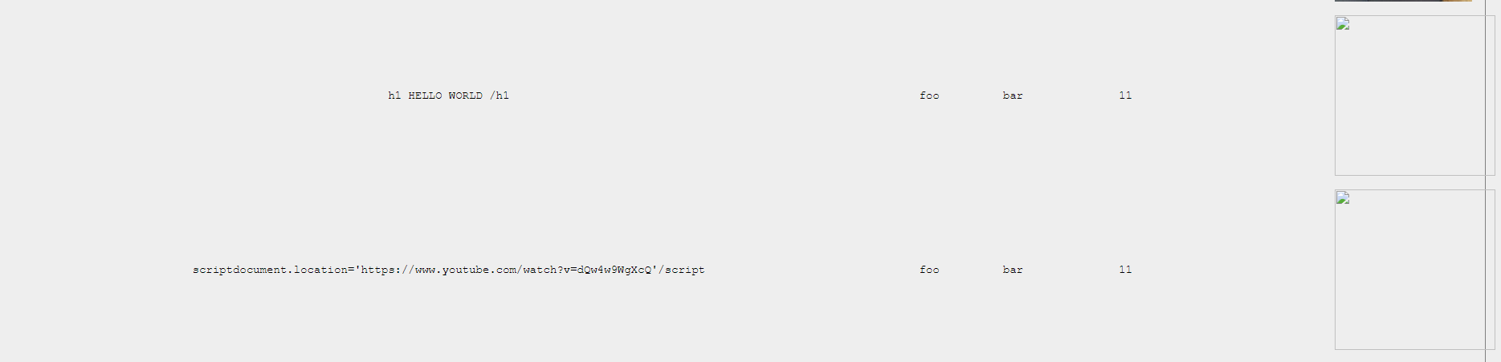

Slide 14




Slide 15
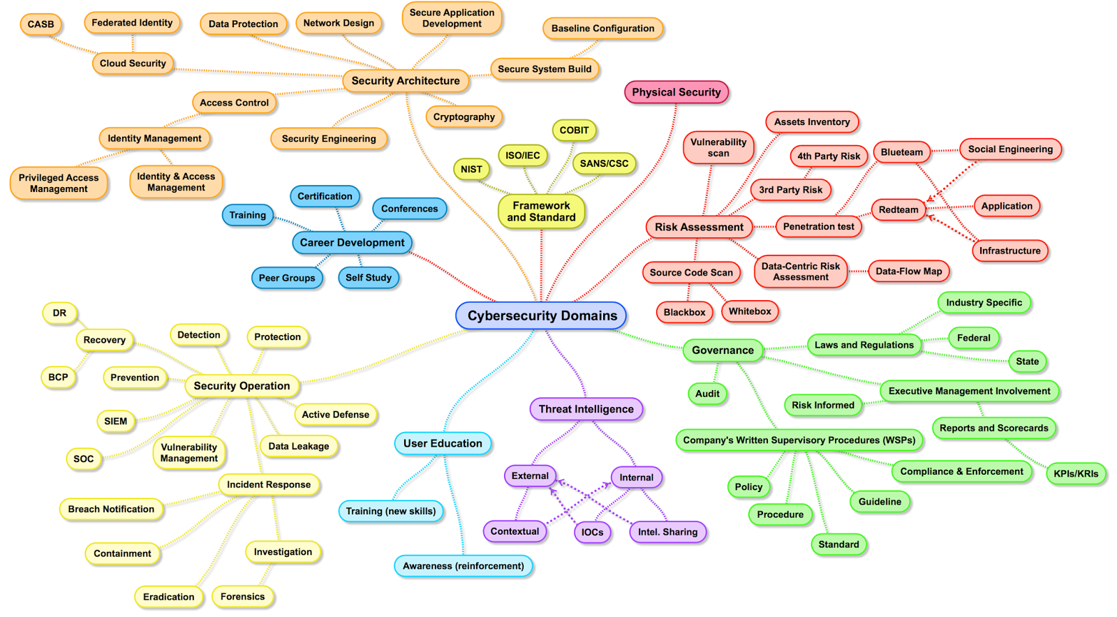
What can you do?
Notes:
Who knows what CTF challs are?

Slide 17

Categories boiled down
CTF Challenges: Game like cybersecurity puzzles
Which consist of:
PWN
RE
Forensics
Web
Crypto
Hardware

Slide 18
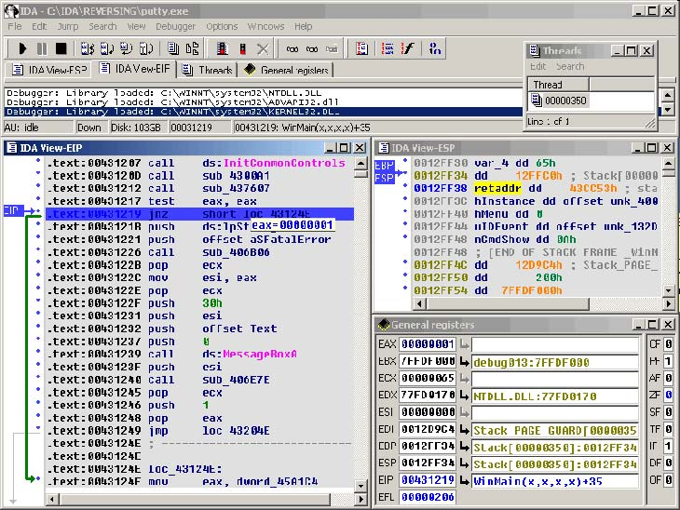
RE
Software Reverse Engineering is a process of recovering the design, requirement specifications and functions of a product from an analysis of its code.

Slide 19
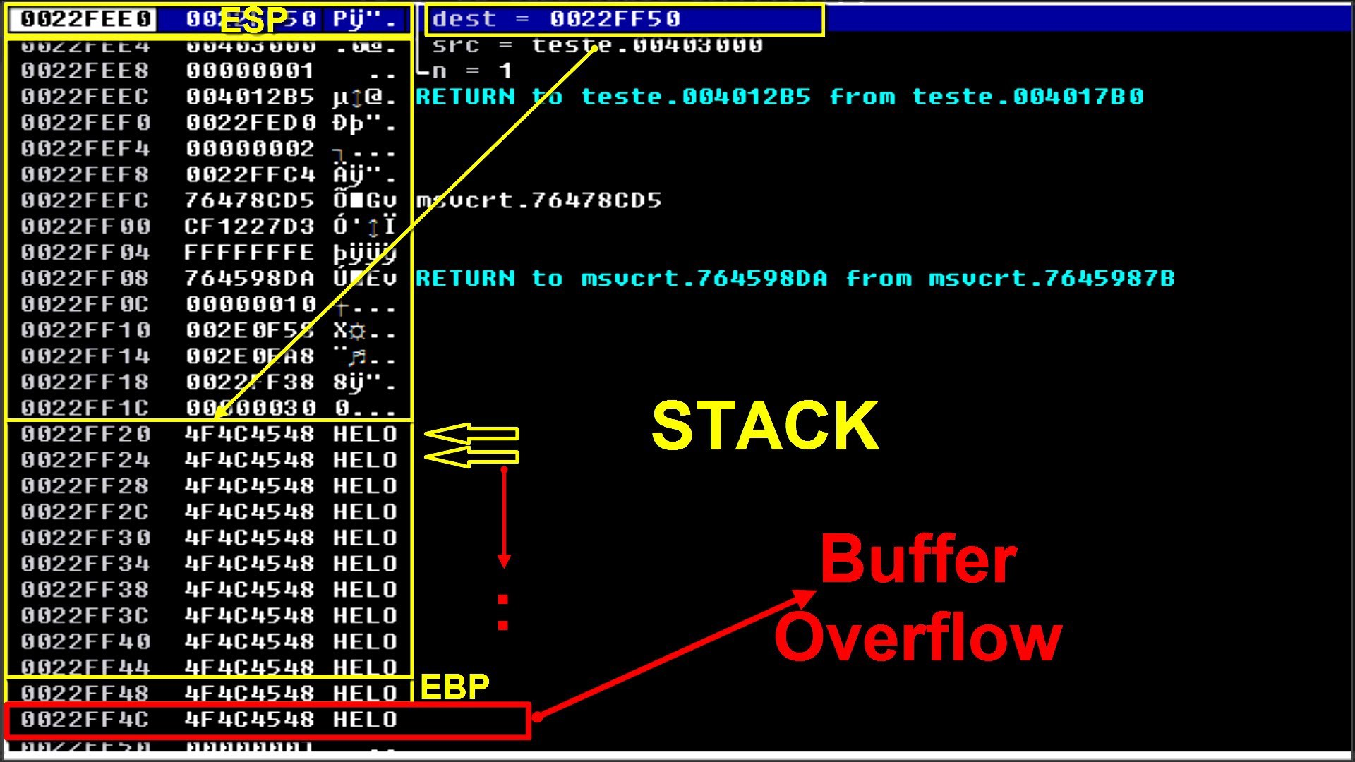

PWN
Exploiting memory handling to gain arbitrary control of the system.
Jobs: Research
VU Sec
(terrace guy)

Slide 20
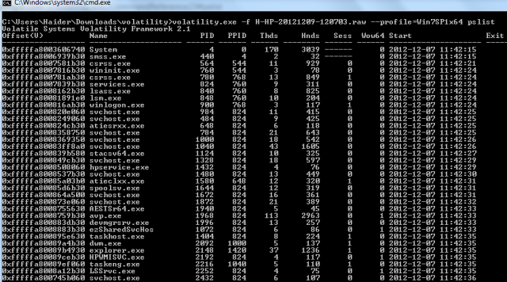
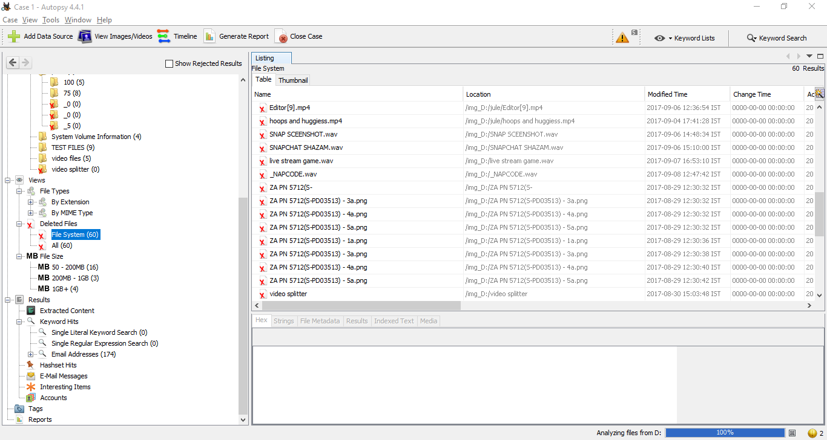
Forensics
Dead box/live response
Jobs:
Incident Response
Investigator
Malware analyst
Private Investigator

Slide 21
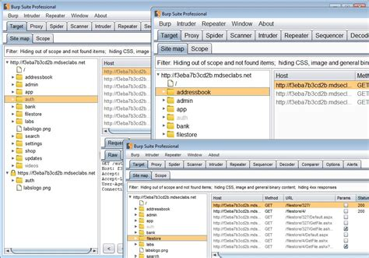
Web
Attempt to exploit logic errors on the back end.
Most common category
Jobs:
Pentester
Code auditing

Slide 22

Crypto
Cryptography is about protecting data with the use of code in order to prevent third parties or the public from reading private messages. It has numerous aspects in information security such as data confidentiality, data integrity or authentication.
Jobs:
Research
Compliance

Slide 23
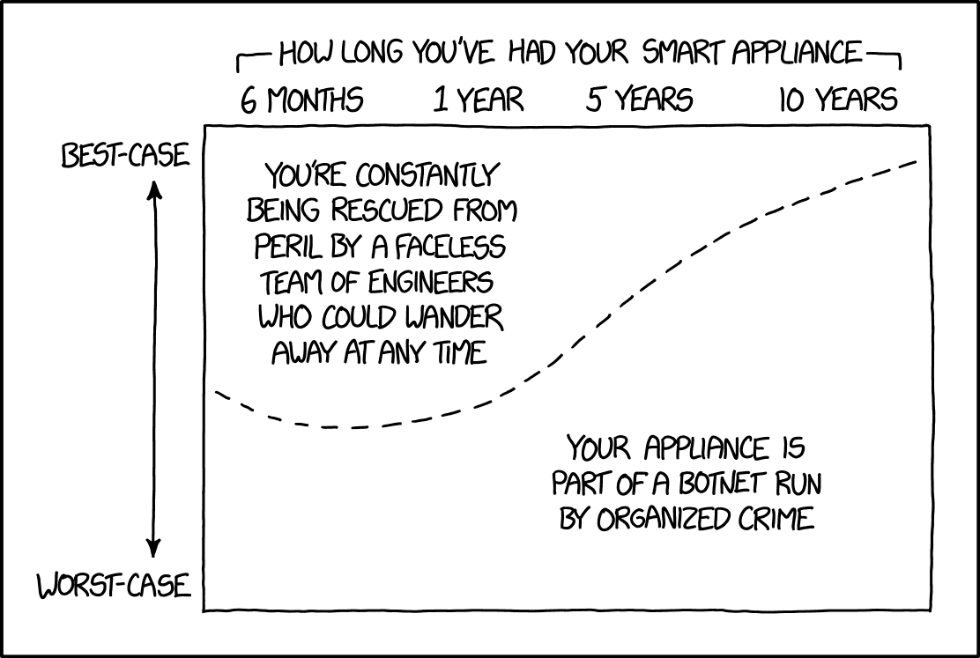
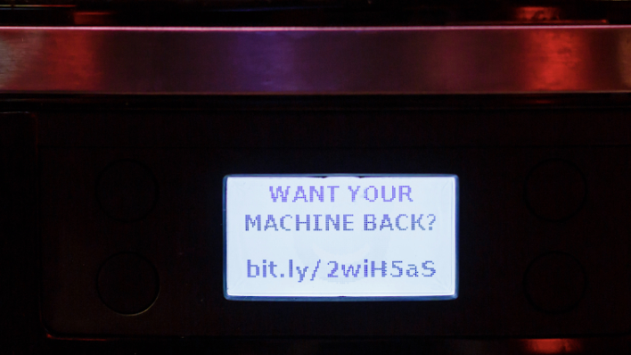
Hardware

Slide 24




Drone
TERRACES

Slide 25
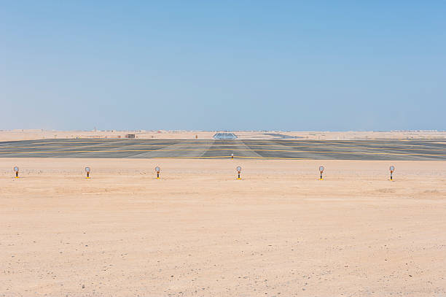
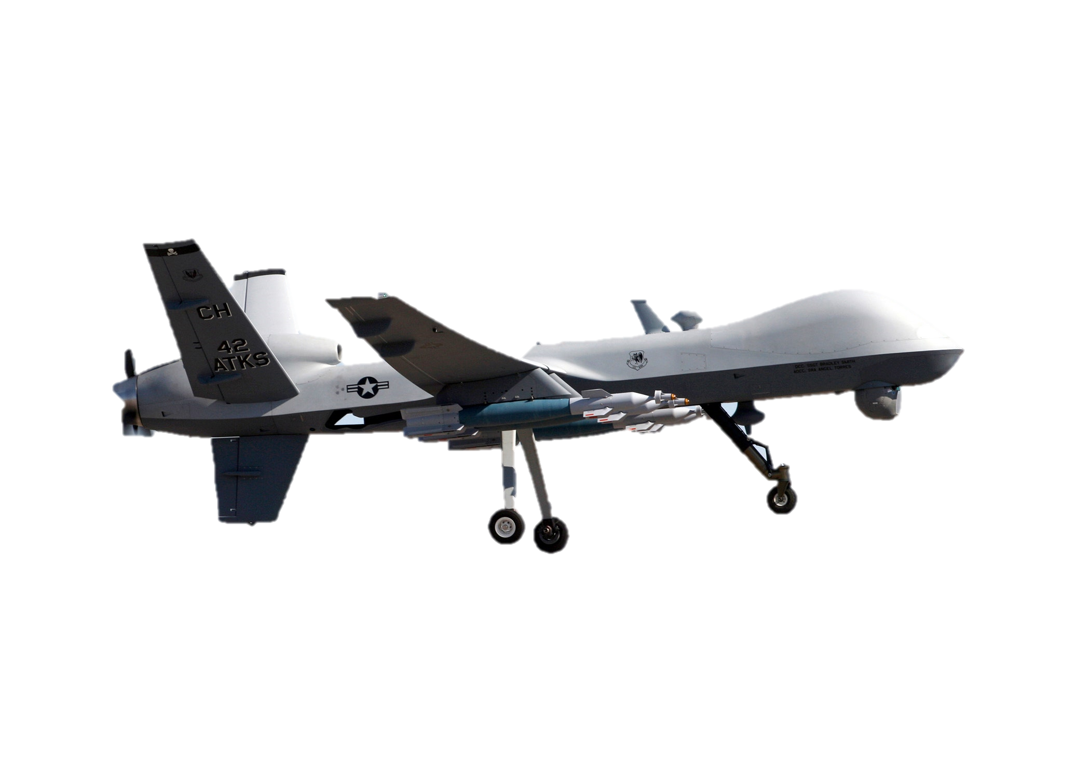

Slide 26


TERRACES

Slide 27
TERRACES

Slide 28
TERRACES

Slide 29
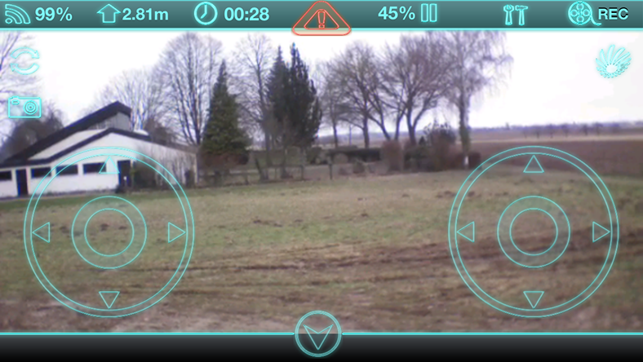
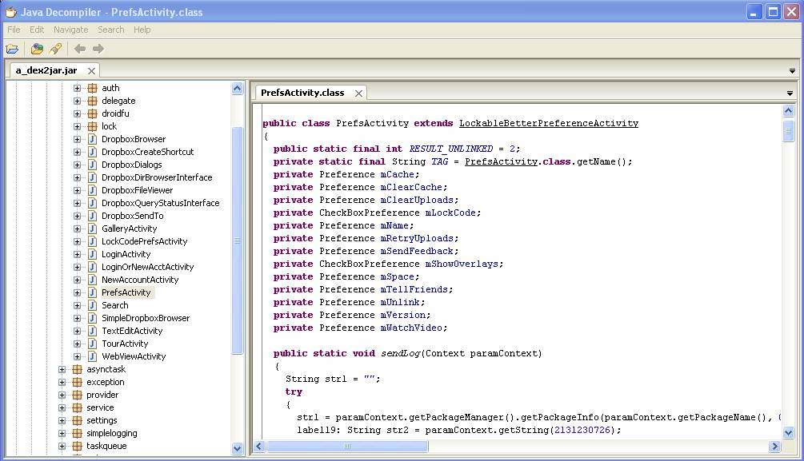
Commands
shoot
spy
Fly
Findings:
Credentials
Faulty Code
Unknown features

Slide 30

Commands
shoot
spy
spy
#13@{
Encryptor
Decryptor

Slide 31


Username = admin
Password = secret
Password = ' OR 1=1 --
SELECT * FROM credentials WHERE username = 'admin' AND password = 'secret'
SELECT * FROM credentials WHERE username = 'admin' AND password = '' OR 1=1 --'​

Slide 32


TERRACES

Slide 33

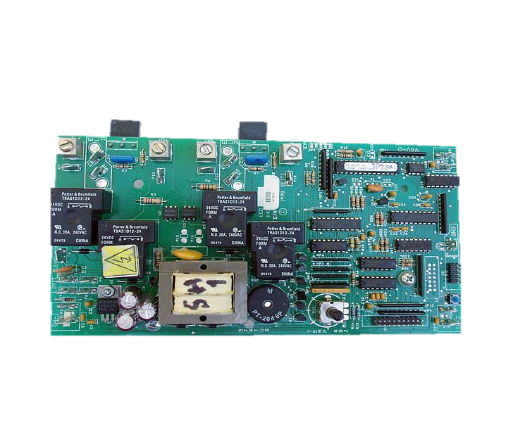

Slide 34







Commands
Forensic findings:
Create a storyline
Uncover vulnerabilities
Play sherlock
Memory
Log
Log
Recordings
Sensors
Traffic Logs
Location Logs

Slide 35
TERRACES

Slide 36
Q&A

